Slide 1


Titolo presentazione sottotitolo
F12 Visual Reconstruction of Played music
Image Analysis and Computer Vision
Prof. Vincenzo Caglioti
Milano, XX mese 20XX
10973015
DENG JIANWEI

Slide 2

1. Problem Formulation 2. Dataset Selection 3. Solution Approach and Implementation 4. Result Analysis and Visualization 5. Conclusions and Future Work
Contents

Slide 3
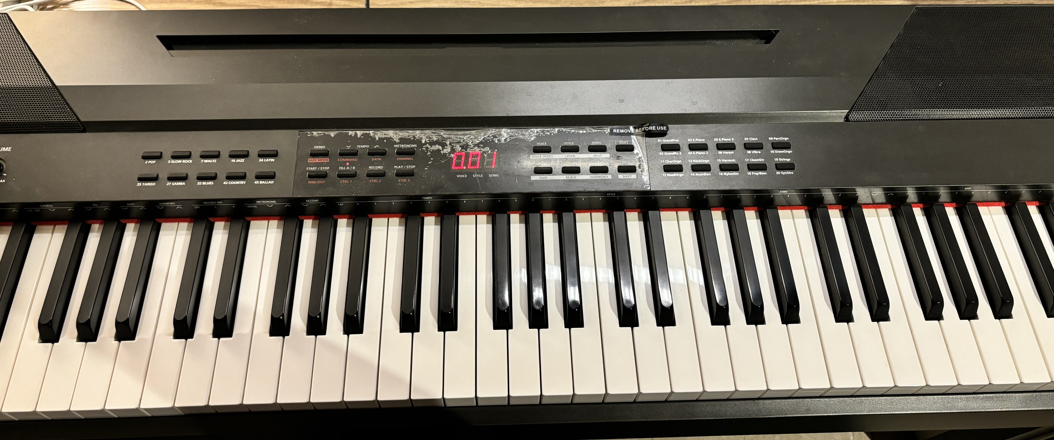
1. Problem Formulation
Goal:
Detect piano keypresses using fingertip trajectories from a single RGB video
Given Information:
(1) RGB video of a hand interacting with a keyboard
(2) Manually labeled piano key regions (key_mapping_fixed.json)
(3) Fingertip positions extracted via MediaPipe
(4) Frame-wise binary labels indicating keypress events
Main Challenges:
(1) How to reliably determine whether a keypress action occurs based on fingertip motion
(2) Ensuring accurate detection of press frames with minimal missed keypresses
(3) Whether the distinction between keypress and non-keypress frames is sufficiently clear for classification

Slide 4
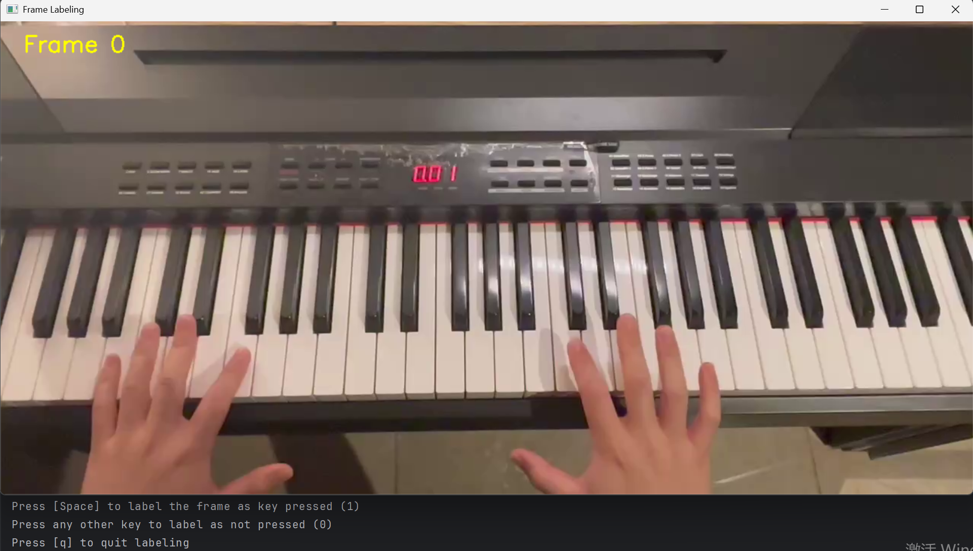
2. Dataset Selection
Equipment & Data:
(1) iPhone 15 camera at 4K resolution (3840×2160) and 60 frames per second (FPS).
(2) A Single RGB pre_training video
(3) Keyboard area corresponding to the video
Ground Truth:
To supervise the training of the key classifier, we manually created ground truth labels based on manual_label_tool.py:
Label type:
Binary label for each frame: 1 if a key was pressed, 0 otherwise.

Slide 5
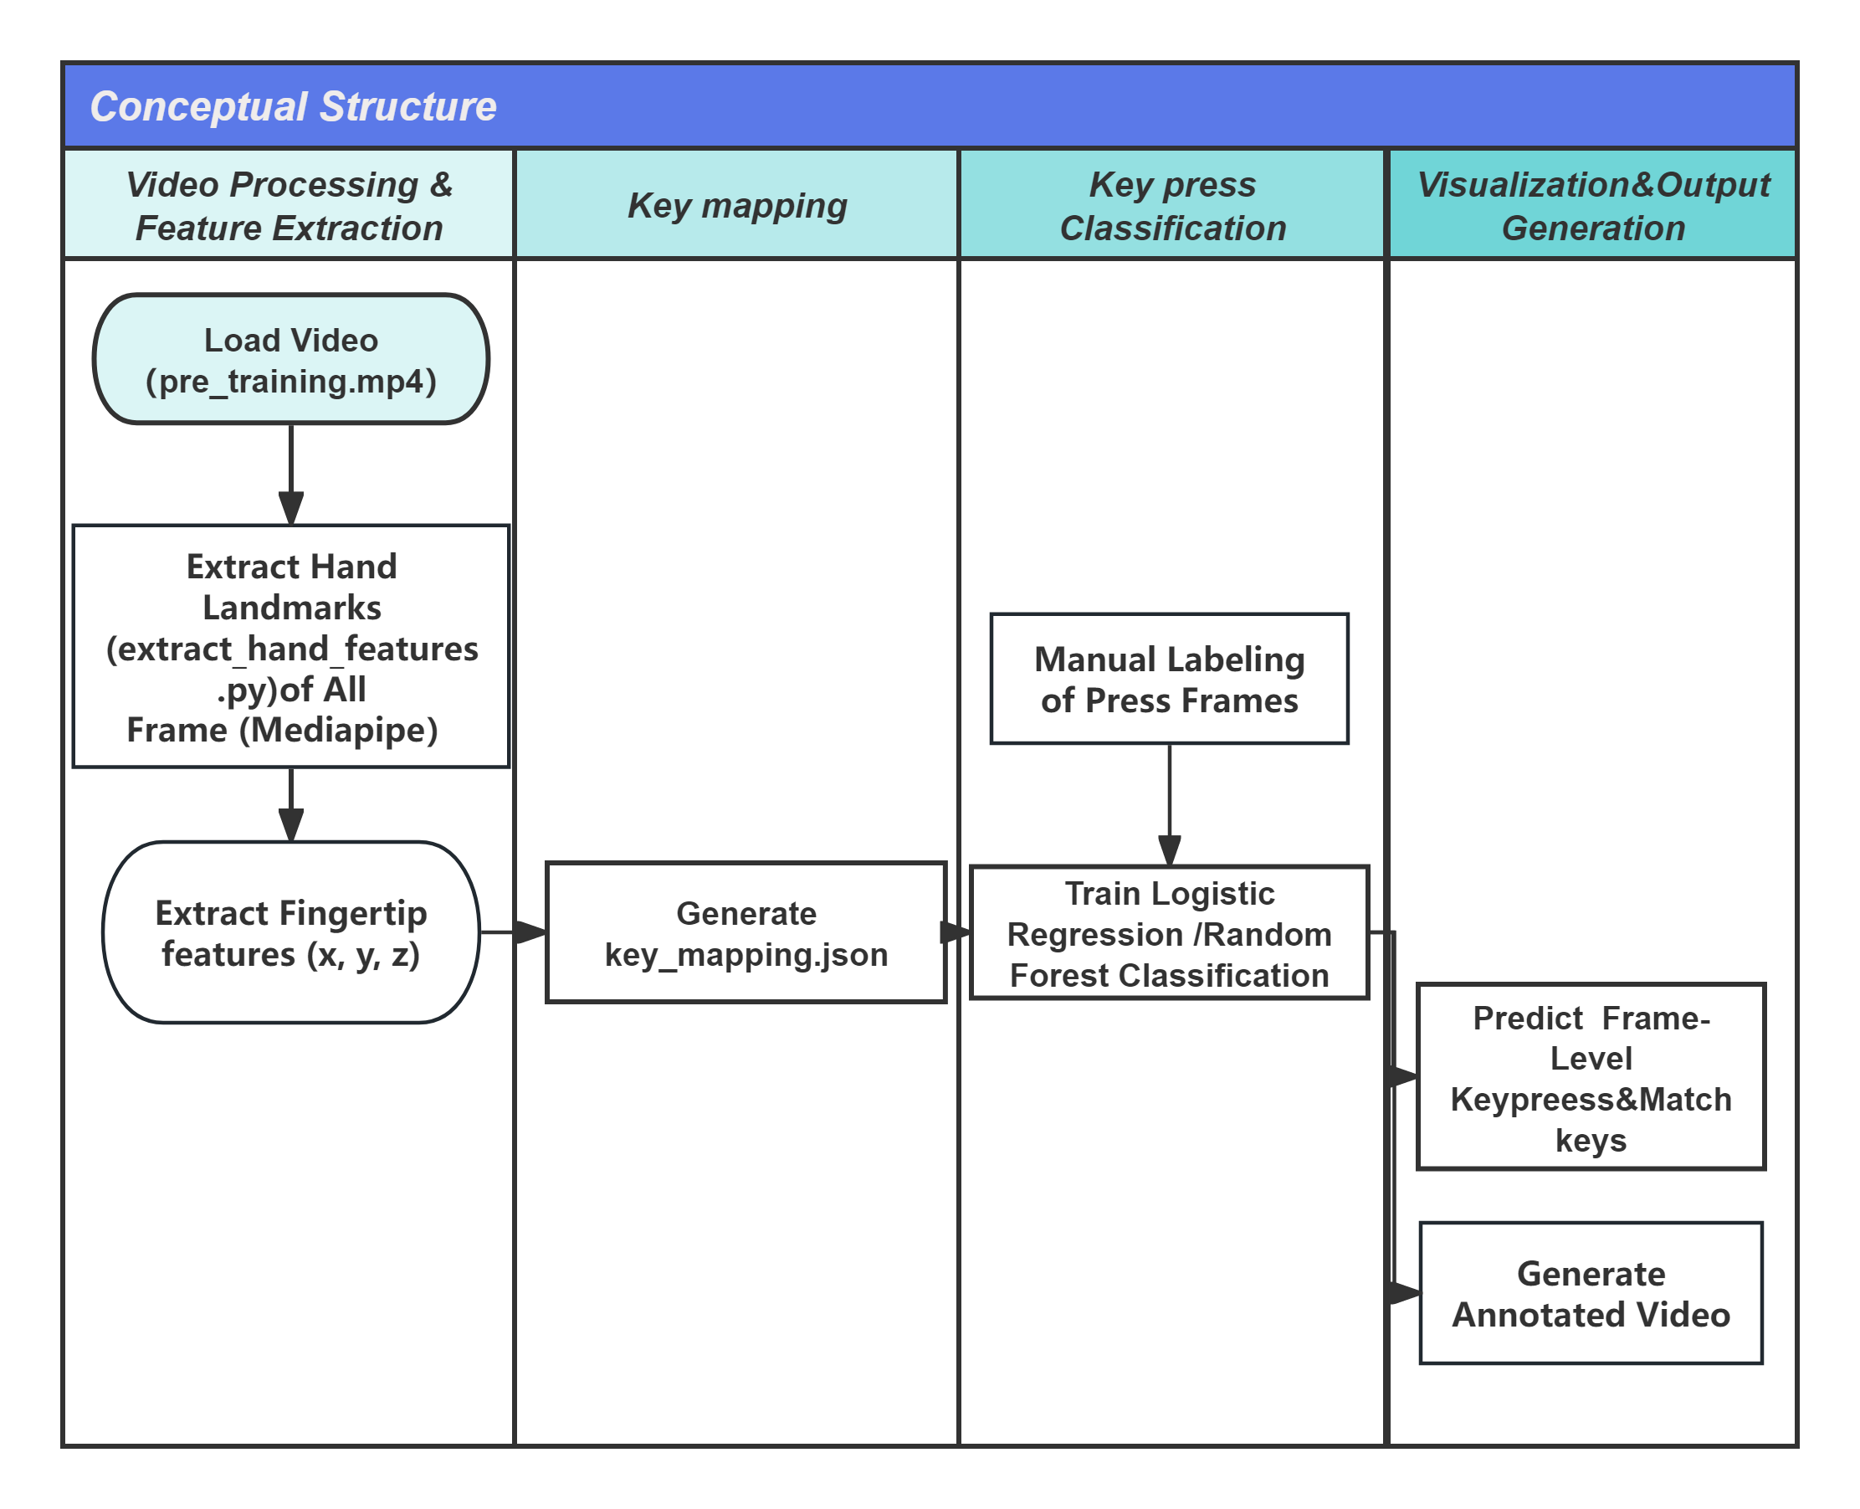
3.Solution Approach and Implementation
Overview Methodology：
This diagram shows the complete pipeline from the original video to the final output with key visualization.

Slide 6
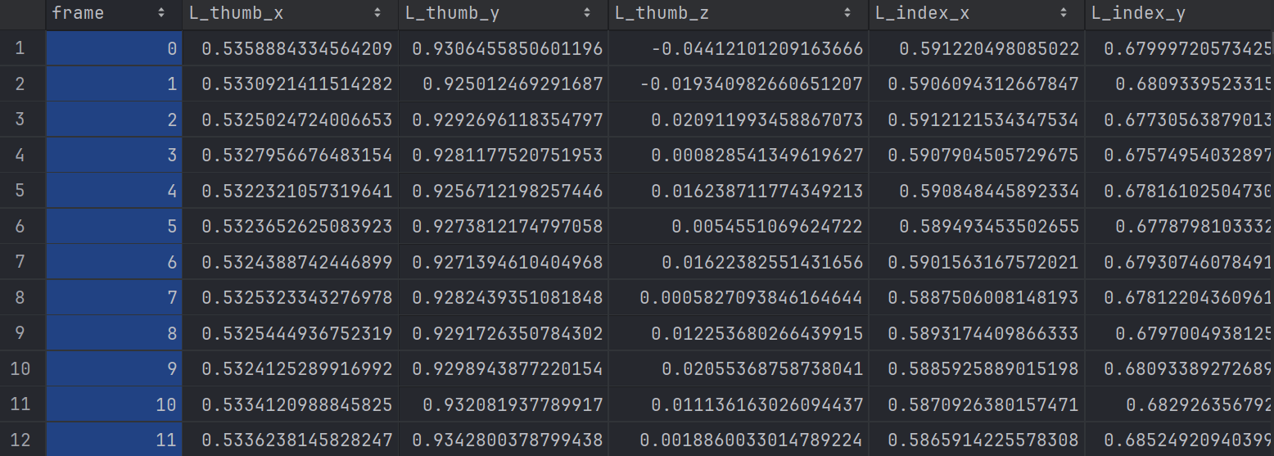
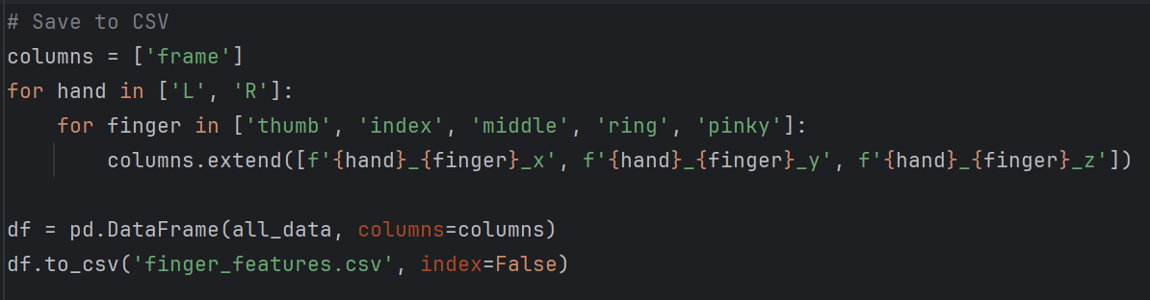
3.Solution Approach and Implementation
3.1 Video-Based Fingertip Feature Extraction
Using MediaPipe Hands, each frame of the input video is processed to extract the 3D coordinates of 10 fingertip key points per frame and save them as a structured CSV file.
Code: extract_hand_features.py
Output: finger_features.csv

Slide 7
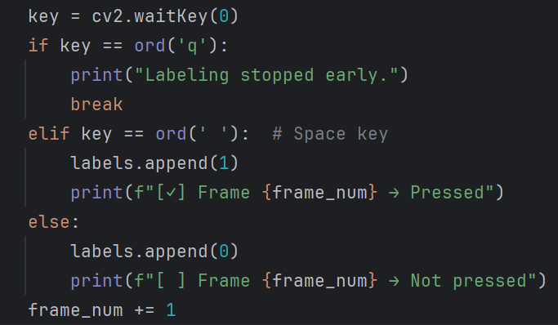
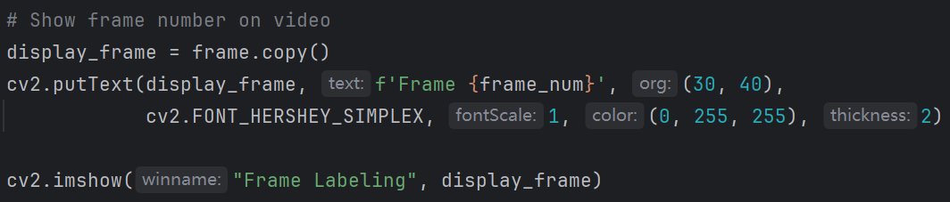
3.Solution Approach and Implementation
3.2 Manual Frame Labeling
Manually label each frame whether it is a key frame (press / no-press) as a supervision signal.
Code: manual_label_tool.py
Output: labels.csv
Part2：Manual Lableing
Part1：Read Frame

Slide 8
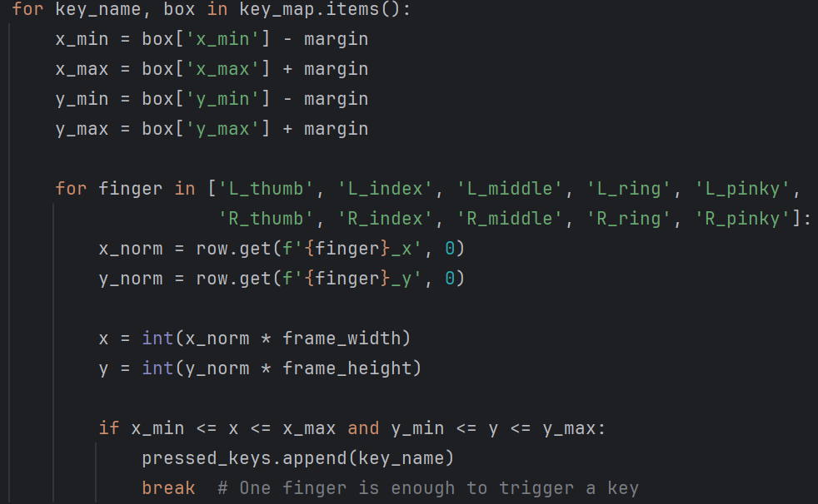
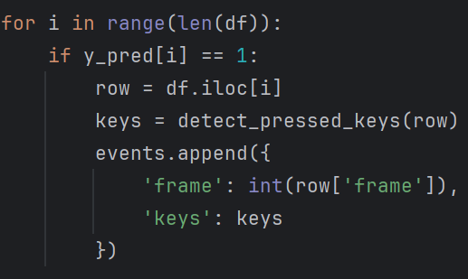
3.Solution Approach and Implementation
3.3 Train Machine Learning Model
Use the random forest model to train binary classification based on fingertip features and labels (pressed/not pressed).
Code: train_classifier.py
Output: press_classifier.pkl
3.4 Predict Key Presses & Save as JSON
Use the model to predict whether it is a key press frame for each frame, and identify which key is pressed by which finger.
Including：
1.Comparison of the finger position coordinates with the bounding box of the key position
2.Only frames where a key is predicted to be pressed are kept and mapped.
Code: predict_key_presses.py
Output: press_events.json

Slide 9
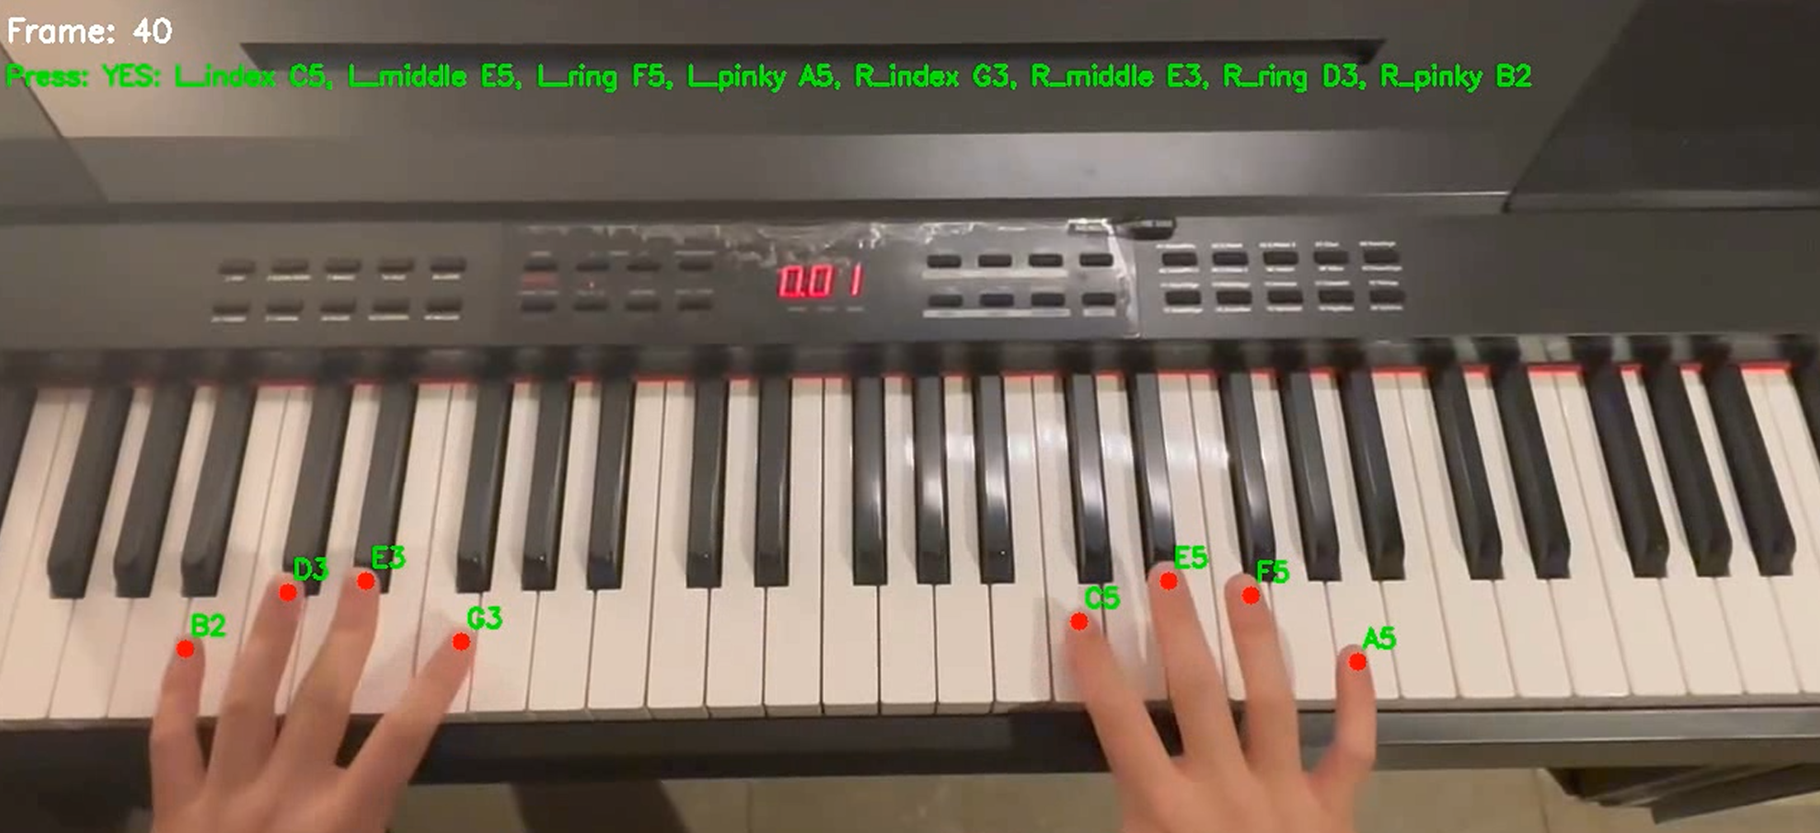
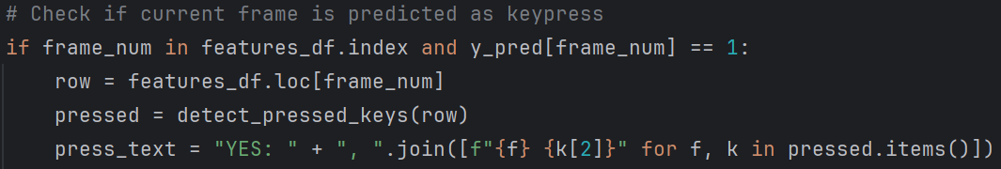
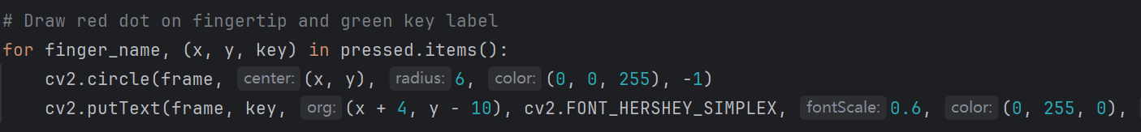
3.Solution Approach and Implementation
3.5 Final Video Visualization
Visualize the prediction results into an annotated video, display the key action and corresponding finger of each frame and output.
Code: visualize_dynamic_keys.py
Output: output_annotated_with_keys.mp4

Slide 10
4.1 Machine Learning Result Analysis
Method Overview:
1. It is a binary classification problem (press / no press) that requires learning nonlinear decision boundaries based on less data:
2. The pattern of pressing actions is complex and not suitable for simple modeling.
Difficulty:
1.The finger position in each frame is a continuous numerical feature (x, y, z):
2.It is impossible to use simple rules to determine "whether to press" because the
finger approaching does not mean pressing.
3.Different users, pressing angles, and speeds all lead to large changes trajectory,making it difficult to manually design accurate judgment logic.

Slide 11
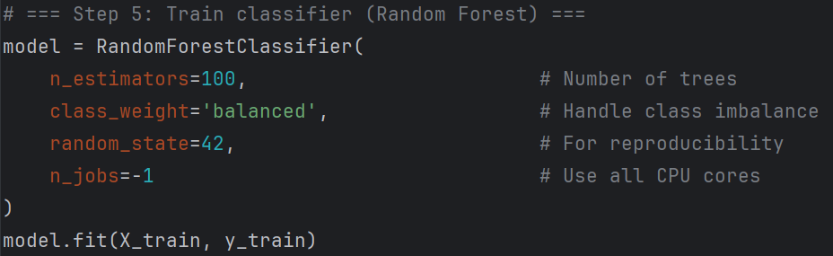
4.1 Machine Learning Result Analysis
Model Principle & Advantages and Disadvantages;
1.Logistic Regression： Simple, linear model; suitable for linear relationship between features and labels
2.Random Forest： Non-linear model, composed of multiple decision trees; can automatically model complex feature combinations and interactions(Better)
Main Steps:
1.Load Data
2.Merge Features and Labels
3.Prepare Training Inputs
4.Split Train/Test Sets
5.Train Random Forest Model
6.Evaluate Model Performance
7.Save Trained Model

Slide 12
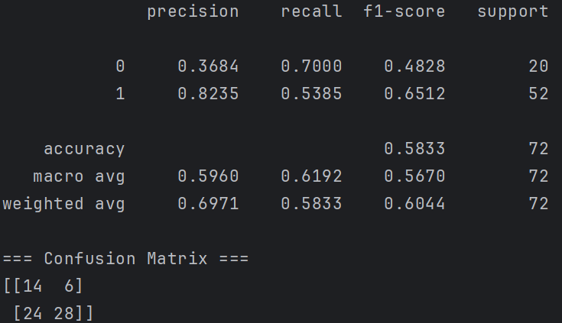
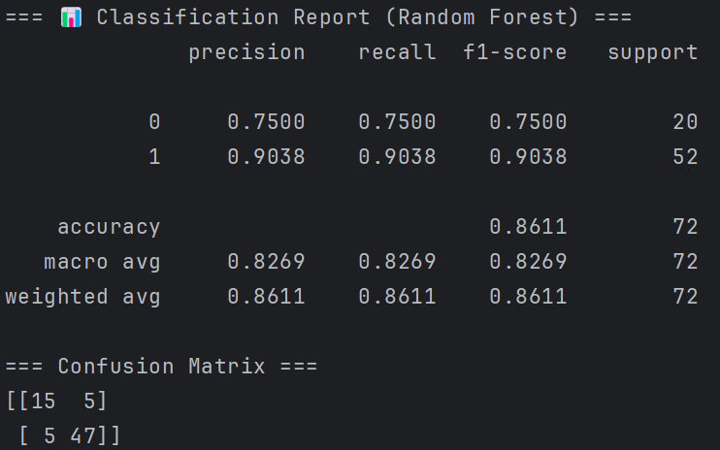
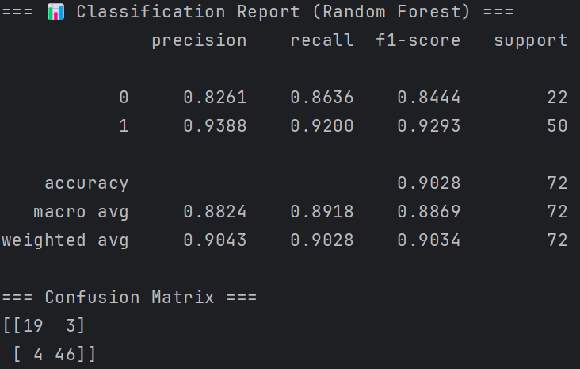
4.1 Machine Learning Result Analysis
Classification results display
Logistic Regression
Overall Accuracy：58.33%
Random Forest Classification（Test 1）
Overall Accuracy：86.11%
Random Forest Classification（Test 2）
Overall Accuracy：90.28%

Slide 13
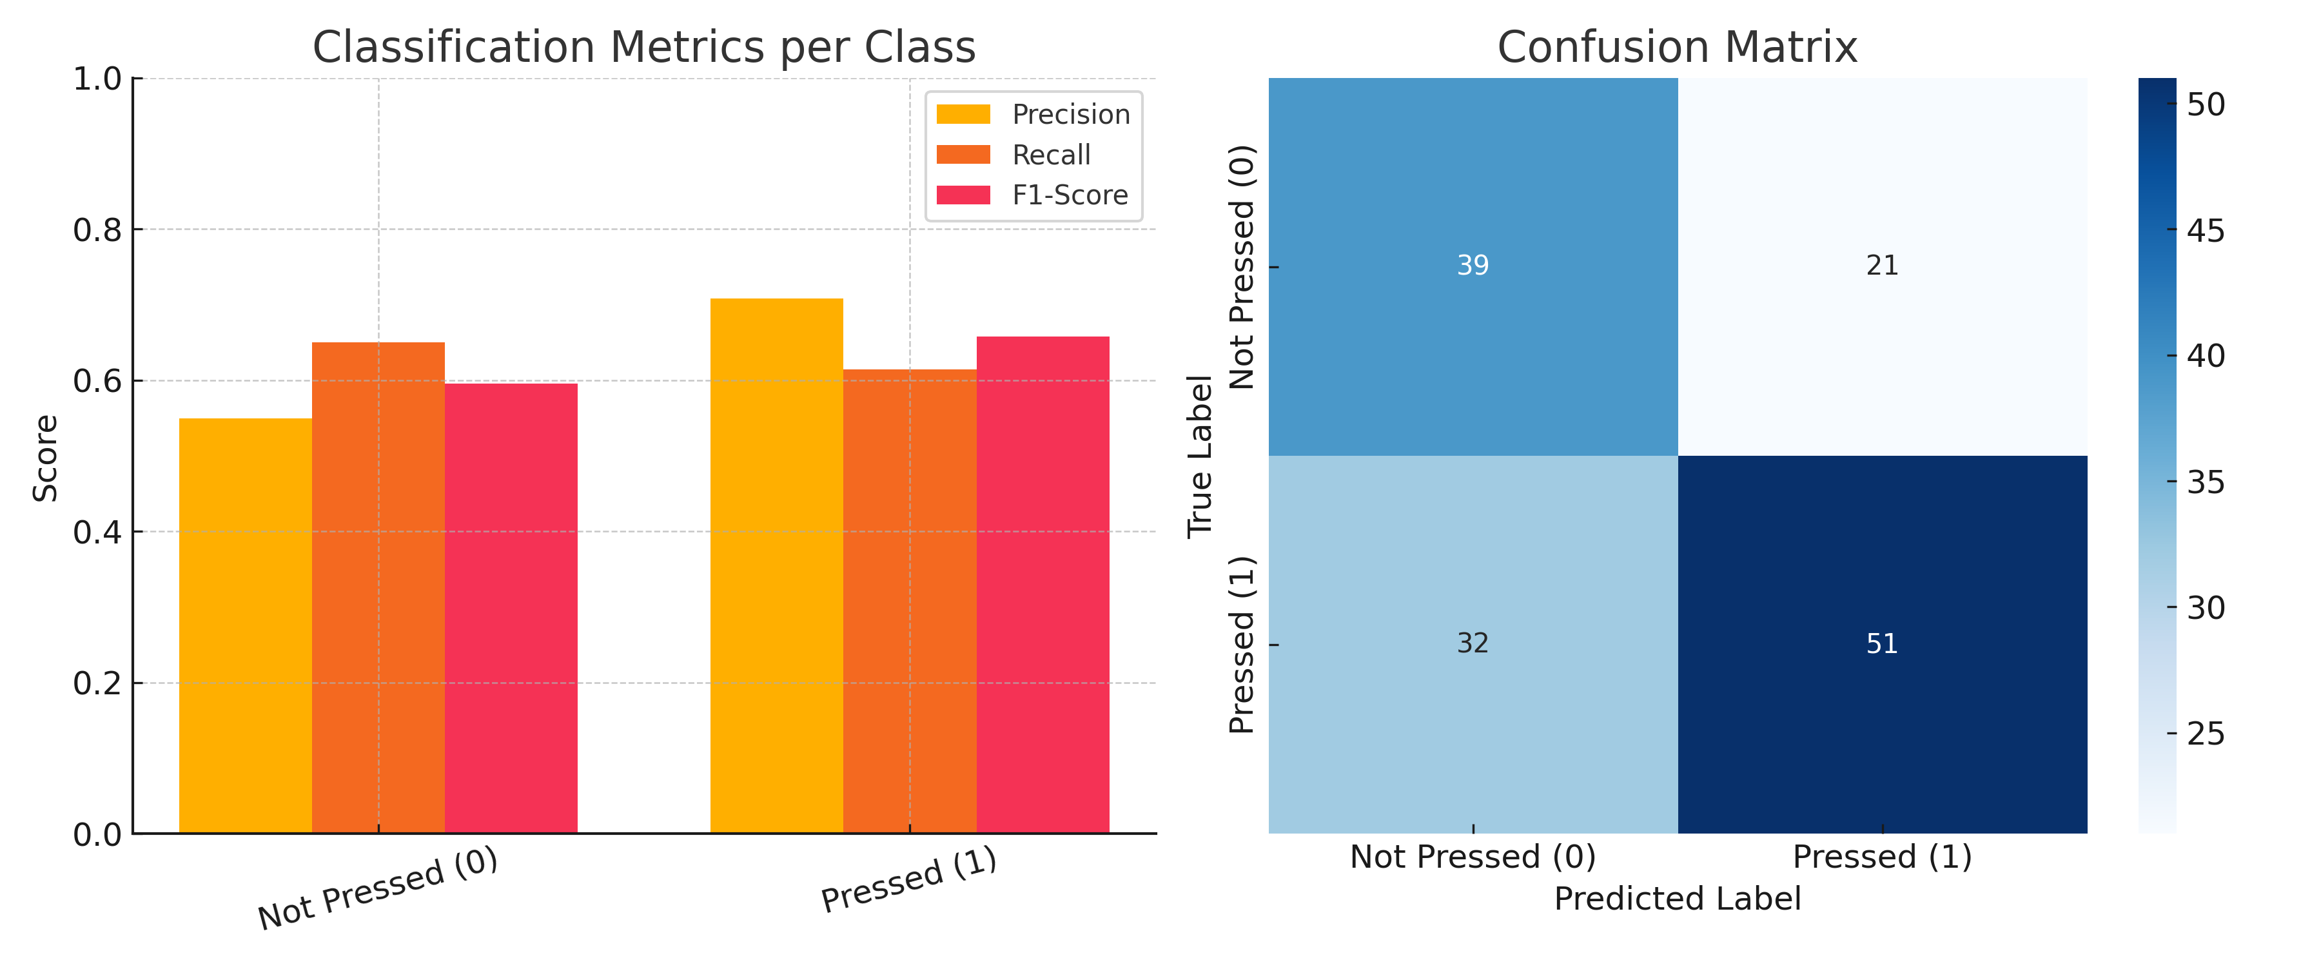
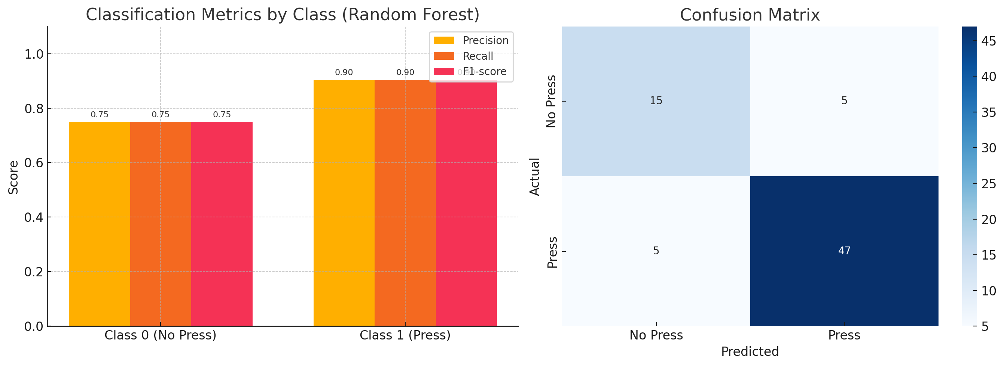
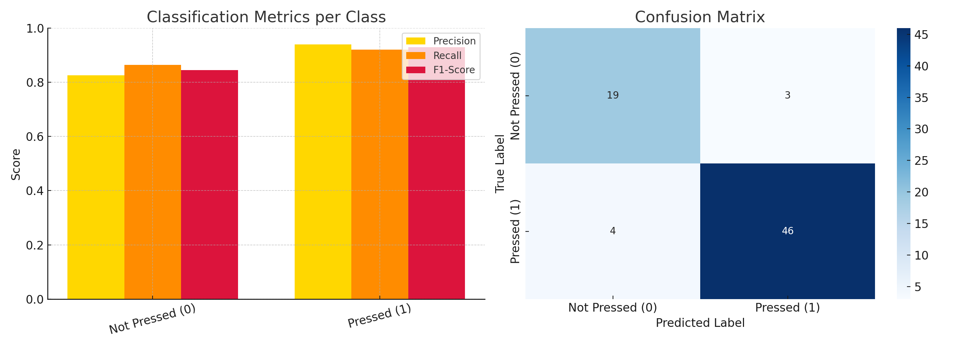
4.2 Machine Learning Result Visualization

Slide 14
5. Conclusions and Future Work
Achievements:
Extracted structured numerical features from fingertip positions in each frame;
Manually create a binary classification dataset (press vs no-press).
Successfully trained a Random Forest classifier (Over 90% accuracy);
Automated video annotation system shows which finger presses key;
Future Improvements:
Use temporal models(Hand Segmentation) to better capture motion over time.
Expand dataset with more users, hand types, and camera angles.
Improve finger-specific classification for more precise detection.(“Cover” vs “Press”)

Slide 15
Thanks for your attention!

